Slide 1
MAESTRO Workshop #4
A Mutlispecies Model
Using Life Table Reconstruction
to develop an Ecosystem Model
Sub project 4.2
David Keith, Heather Bowlby

Slide 2
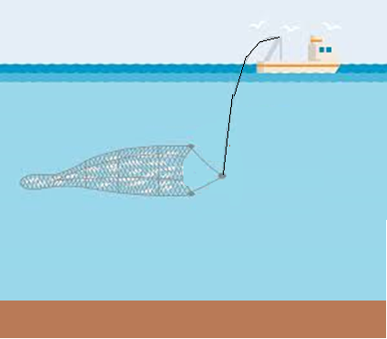


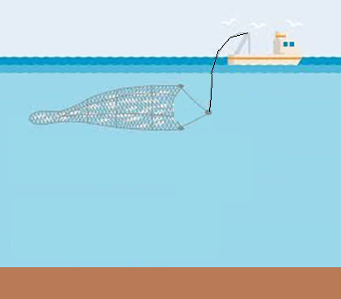



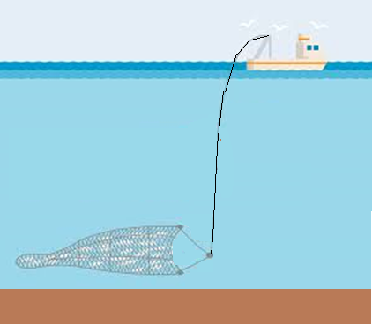
Task 4 Objectives
Explore the impact of varying catch strategies on the diversity of stocks within an ecosystem
How does redistributing catch across species impact function diversity
Are their optimal harvesting strategies that can optimize functional diversity

Slide 3
Task 4 Objectives
Explore the impact of varying catch strategies on the diversity of stocks within an ecosystem
How does redistributing catch across species impact function diversity
Are their optimal harvesting strategies that can optimize functional diversity
How might climate impacts influence these strategies

Slide 4
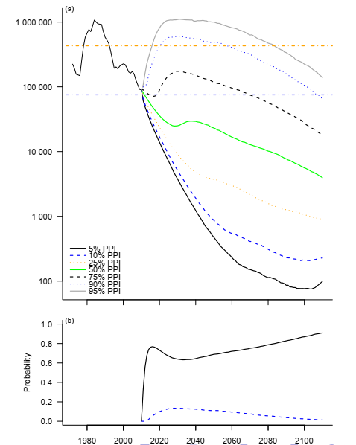
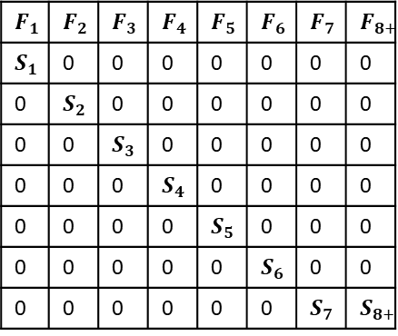
The Incidental Catch Model Life Table Reconstruction
To do this we need a model to project into the future
For both data limited and data rich stocks
For data rich stocks it would be nice to use the past to inform the future
For data poor stocks we could use life history information
Widely available life history information can be used to estimate
Longevity
Fecundity
Natural Mortality
This + linear algebra is all we need to estimate population growth rates
Leslie matrix
The Incidental Catch Model (ICM)
Enables us to use data from data rich stocks to parameterize model
Enables us to use life history information for data poor stocks to parameterize model
$$F_{1}$$ | $$F_{2}$$ | $$F_{3}$$ | $$F_{4}$$ | $$F_{5}$$ | $$F_{6}$$ | $$F_{7}$$ | $$F_{8+}$$
$$S_{1}$$ | 0 | 0 | 0 | 0 | 0 | 0 | 0
0 | $$S_{2}$$ | 0 | 0 | 0 | 0 | 0 | 0
0 | 0 | $$S_{3}$$ | 0 | 0 | 0 | 0 | 0
0 | 0 | 0 | $$S_{4}$$ | 0 | 0 | 0 | 0
0 | 0 | 0 | 0 | $$S_{5}$$ | 0 | 0 | 0
0 | 0 | 0 | 0 | 0 | $$S_{6}$$ | 0 | 0
0 | 0 | 0 | 0 | 0 | 0 | $$S_{7}$$ | $$S_{8+}$$

Slide 5
What is Life Table Reconstruction?
Developed for sharks
Used life history information and catch history to reconstruct population dynamics
Life history data included
Size
Longevity
Offspring production
A time series of removals by fisheries (all sources of removals)
An estimate of population size at one point in time
Talk to Heather for more details on how it’s being used for Sharks

Slide 6
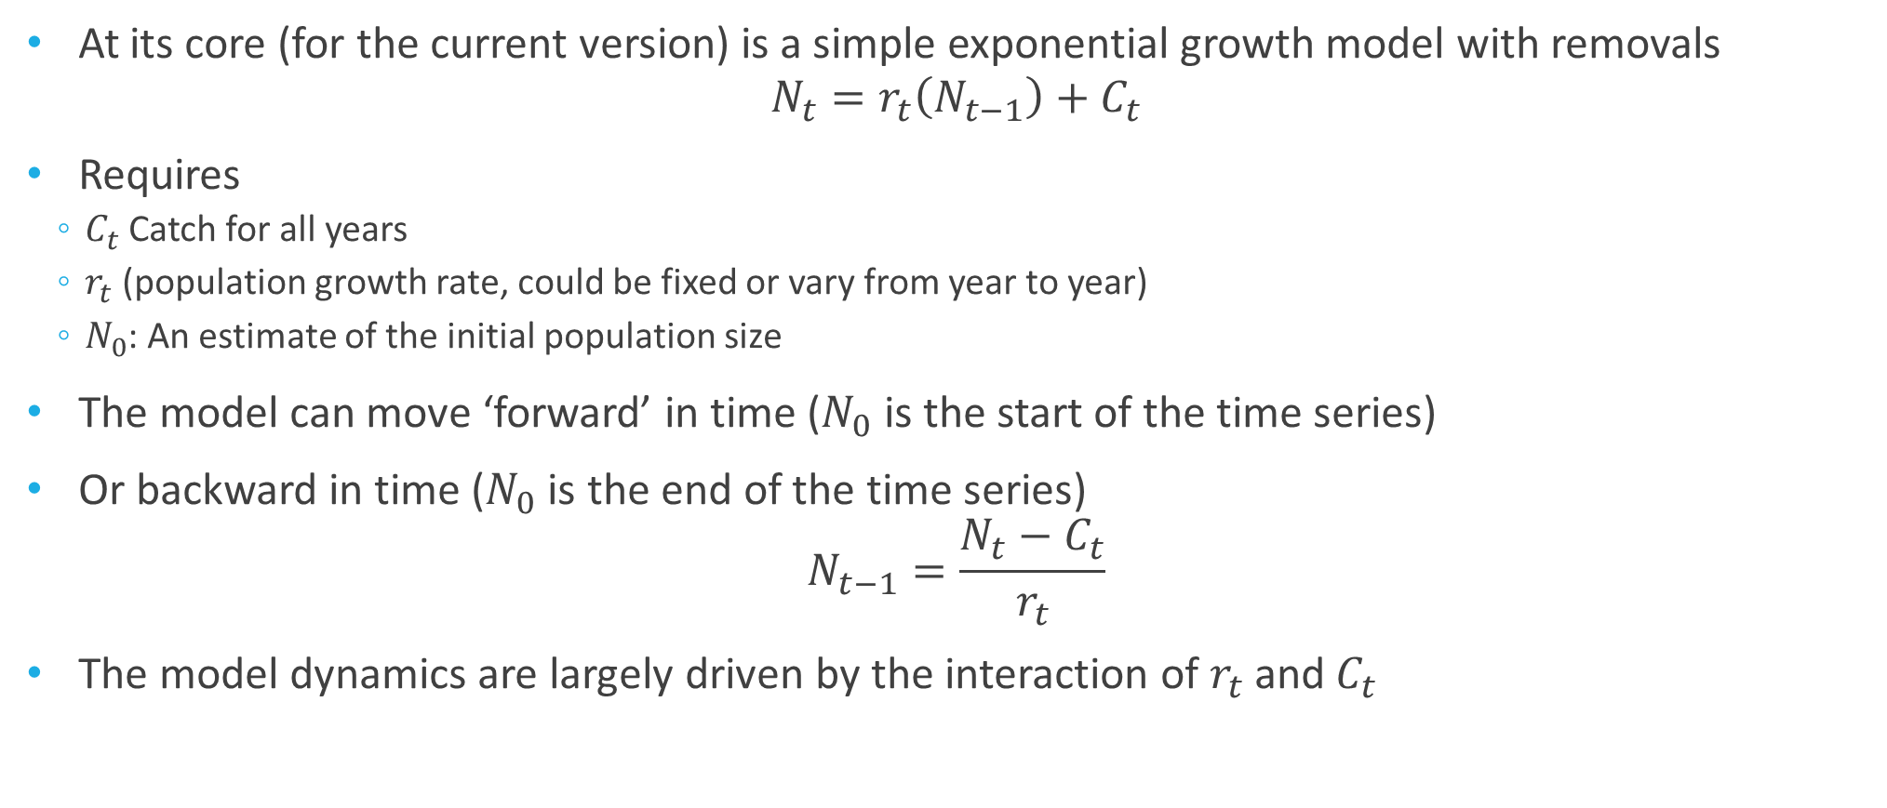
Under the Hood
At its core (for the current version) is a simple exponential growth model with removals
$$N_{t}=r_{t}\left(N_{t−1}\right)+C_{t}$$
Requires
$C_{t}$Catch for all years
$r_{t}$ (population growth rate, could be fixed or vary from year to year)
$N_{0}$: An estimate of the initial population size
The model can move ‘forward’ in time ($N_{0}$ is the start of the time series)
Or backward in time ($N_{0}$ is the end of the time series)
$$N_{t−1}=\frac{N_{t}−C_{t}}{r_{t}}$$
The model dynamics are largely driven by the interaction of $r_{t}$ and $C_{t}$

Slide 7
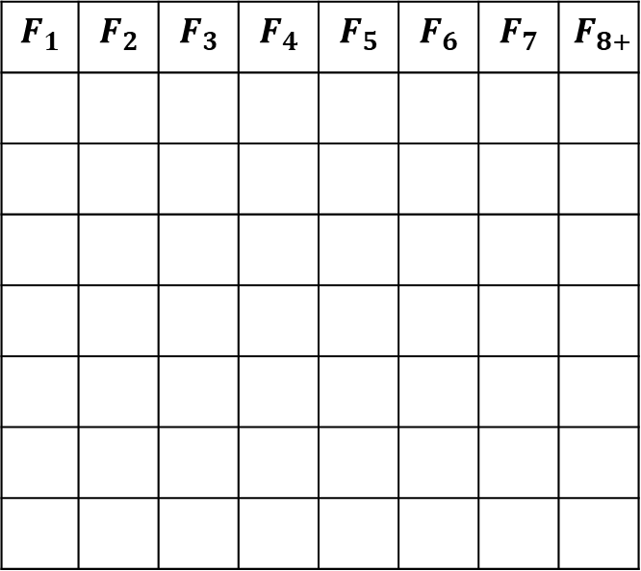
Decomposing $r_{t}$ ($N_{t}=r_{t}\left(N_{t−1}\right)+C_{t}$)
The rate of growth determines how quickly a population grows (or declines)
Driven by fecundity
$$F_{1}$$ | $$F_{2}$$ | $$F_{3}$$ | $$F_{4}$$ | $$F_{5}$$ | $$F_{6}$$ | $$F_{7}$$ | $$F_{8+}$$

Slide 8
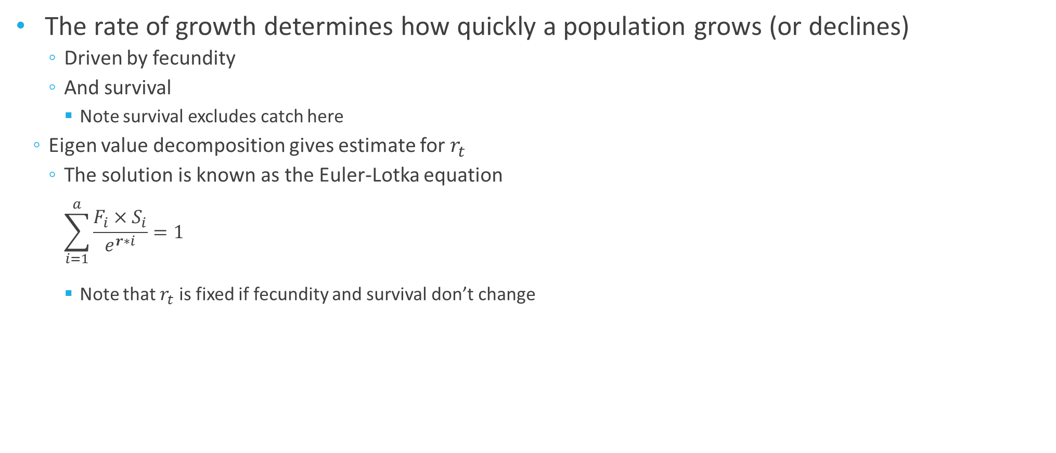
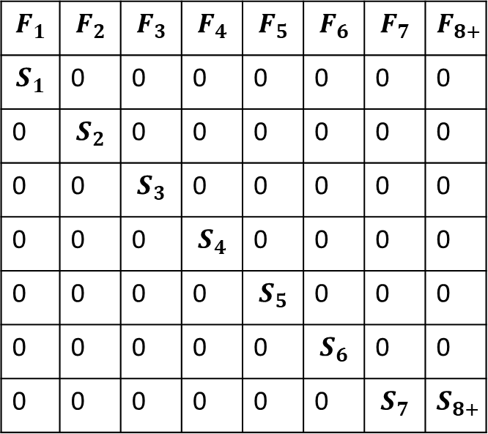
Decomposing $r_{t}$ ($N_{t}=r_{t}\left(N_{t−1}\right)+C_{t}$)
The rate of growth determines how quickly a population grows (or declines)
Driven by fecundity
And survival
Note survival excludes catch here
Eigen value decomposition gives estimate for $r_{t}$
The solution is known as the Euler-Lotka equation
$$\sum_{i=1}^{a}{\frac{F_{i}×S_{i}}{e^{r∗i}}=1}$$
Note that $r_{t}$ is fixed if fecundity and survival don’t change
$$F_{1}$$ | $$F_{2}$$ | $$F_{3}$$ | $$F_{4}$$ | $$F_{5}$$ | $$F_{6}$$ | $$F_{7}$$ | $$F_{8+}$$
$$S_{1}$$ | 0 | 0 | 0 | 0 | 0 | 0 | 0
0 | $$S_{2}$$ | 0 | 0 | 0 | 0 | 0 | 0
0 | 0 | $$S_{3}$$ | 0 | 0 | 0 | 0 | 0
0 | 0 | 0 | $$S_{4}$$ | 0 | 0 | 0 | 0
0 | 0 | 0 | 0 | $$S_{5}$$ | 0 | 0 | 0
0 | 0 | 0 | 0 | 0 | $$S_{6}$$ | 0 | 0
0 | 0 | 0 | 0 | 0 | 0 | $$S_{7}$$ | $$S_{8+}$$

Slide 9
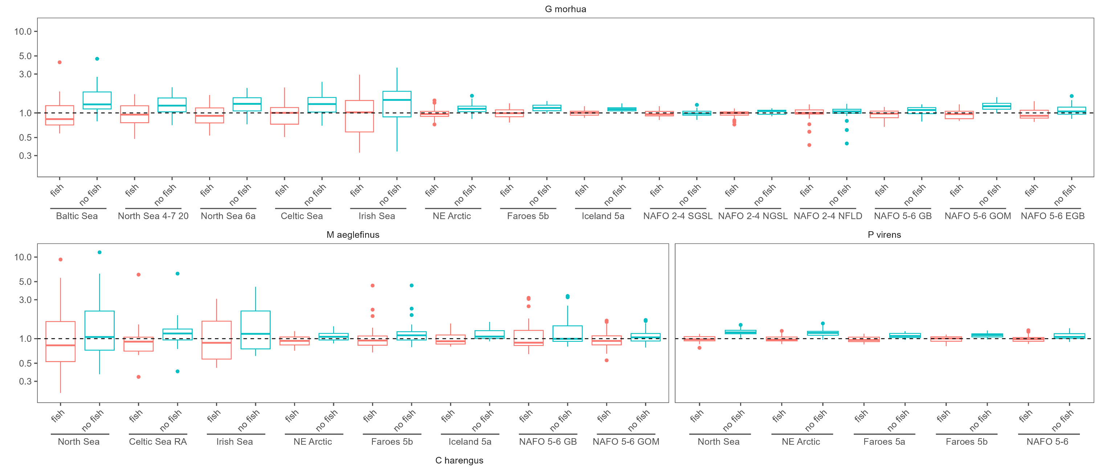
LTR Results
Used a Marine Fisheries Database
To recreate population trends
We have 82 data rich stocks (14 in the North Sea)
Provides us with the characteristics of the demographic parameters
Lambda

Slide 10
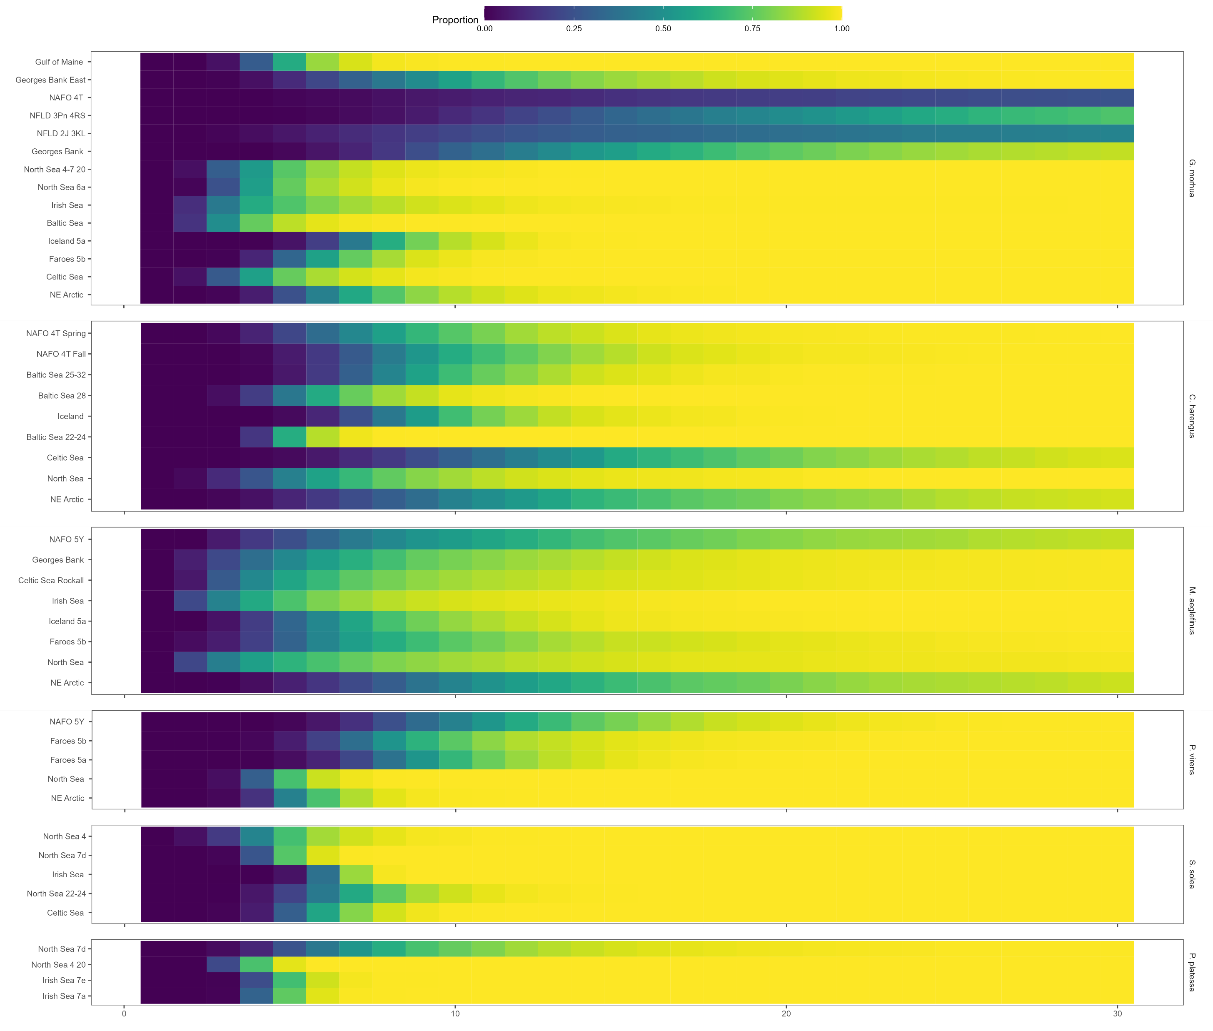

LTR Results
Demographic rates highly variable within species
Proportion of Simulations in which stock has doubled in size by year X

Slide 11
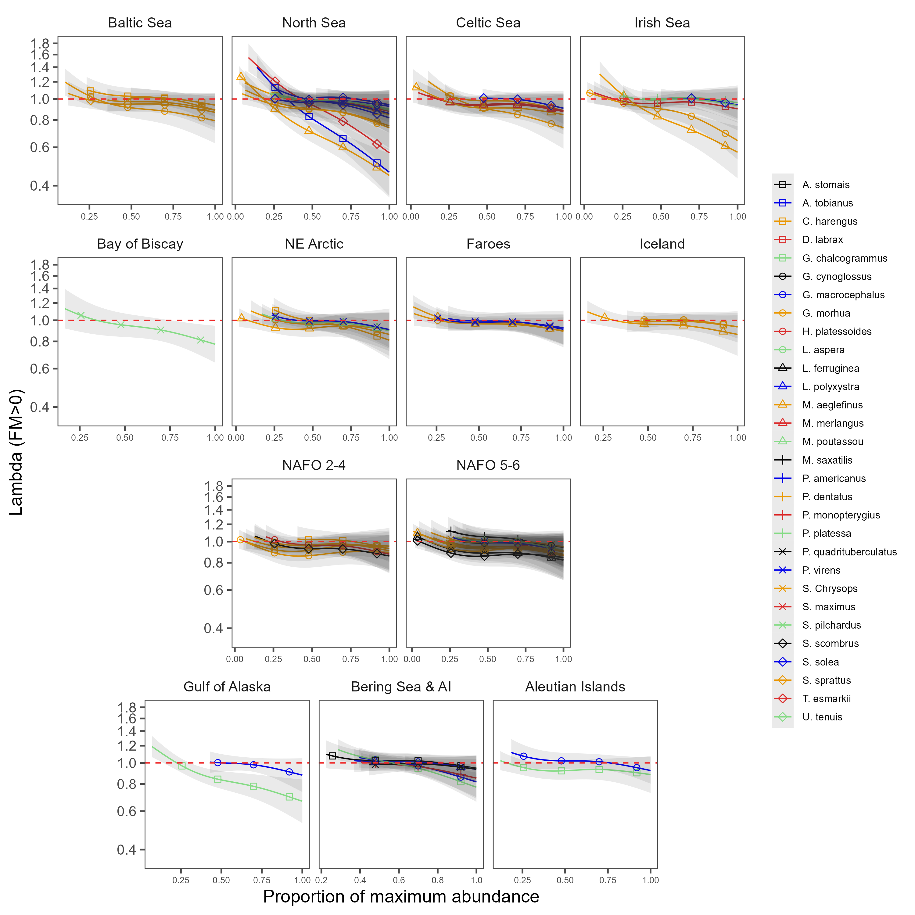
LTR Results
Clear evidence for density dependence….usually… though strength is highly variable
Lambda
Proportion of maximum abundance

Slide 12
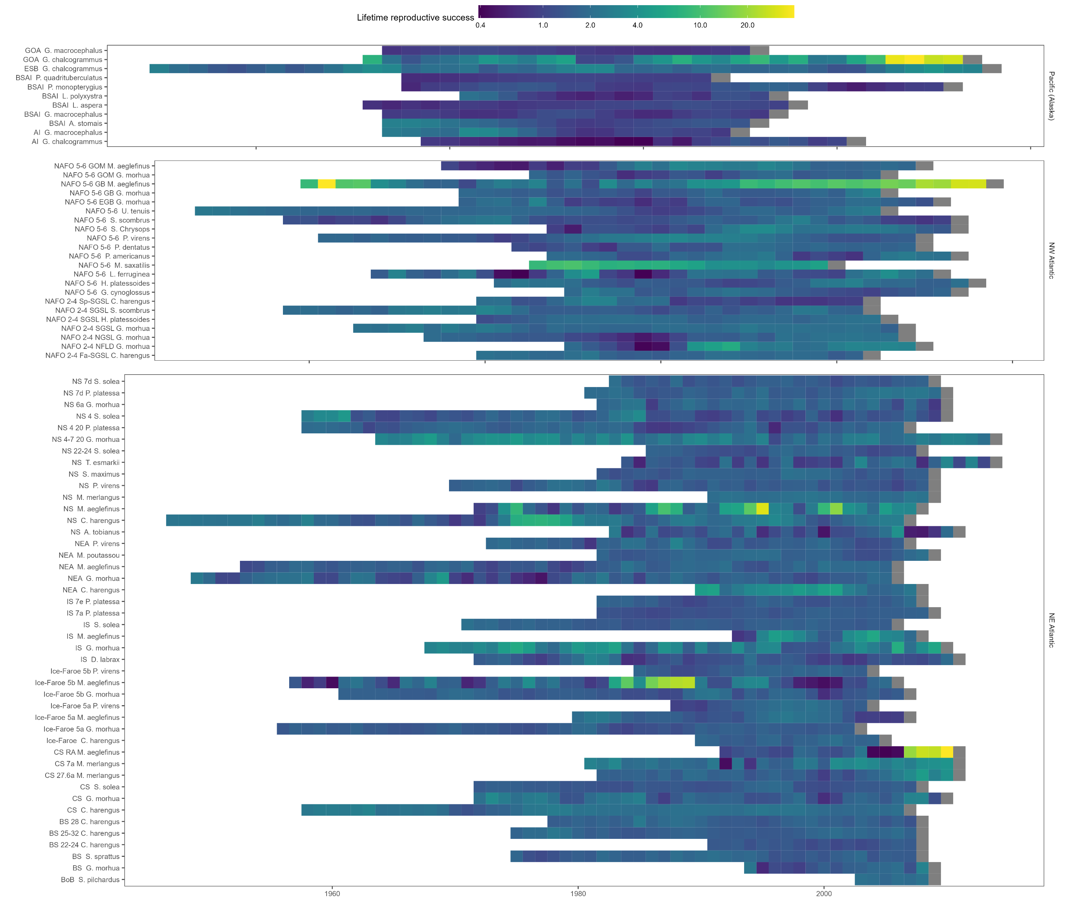


LTR Results
Demographic rates often do not follow life history theory

Slide 13
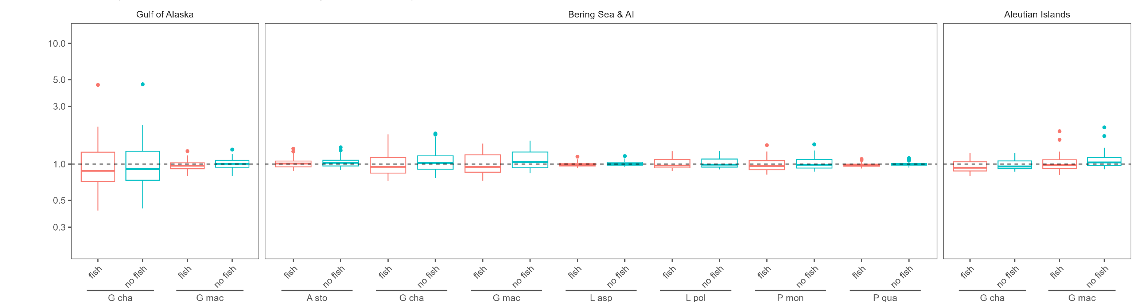
LTR General Takeaways
Basing demographics on general life-history characteristics is a bad idea
Need to consider environment and life-history together
Supports a moderate fishery (F≈ 0.18)
Supports a huge fishery
(F ≈ 0.32)
≈ no fishing since 2000
(F < 0.01)

Slide 14
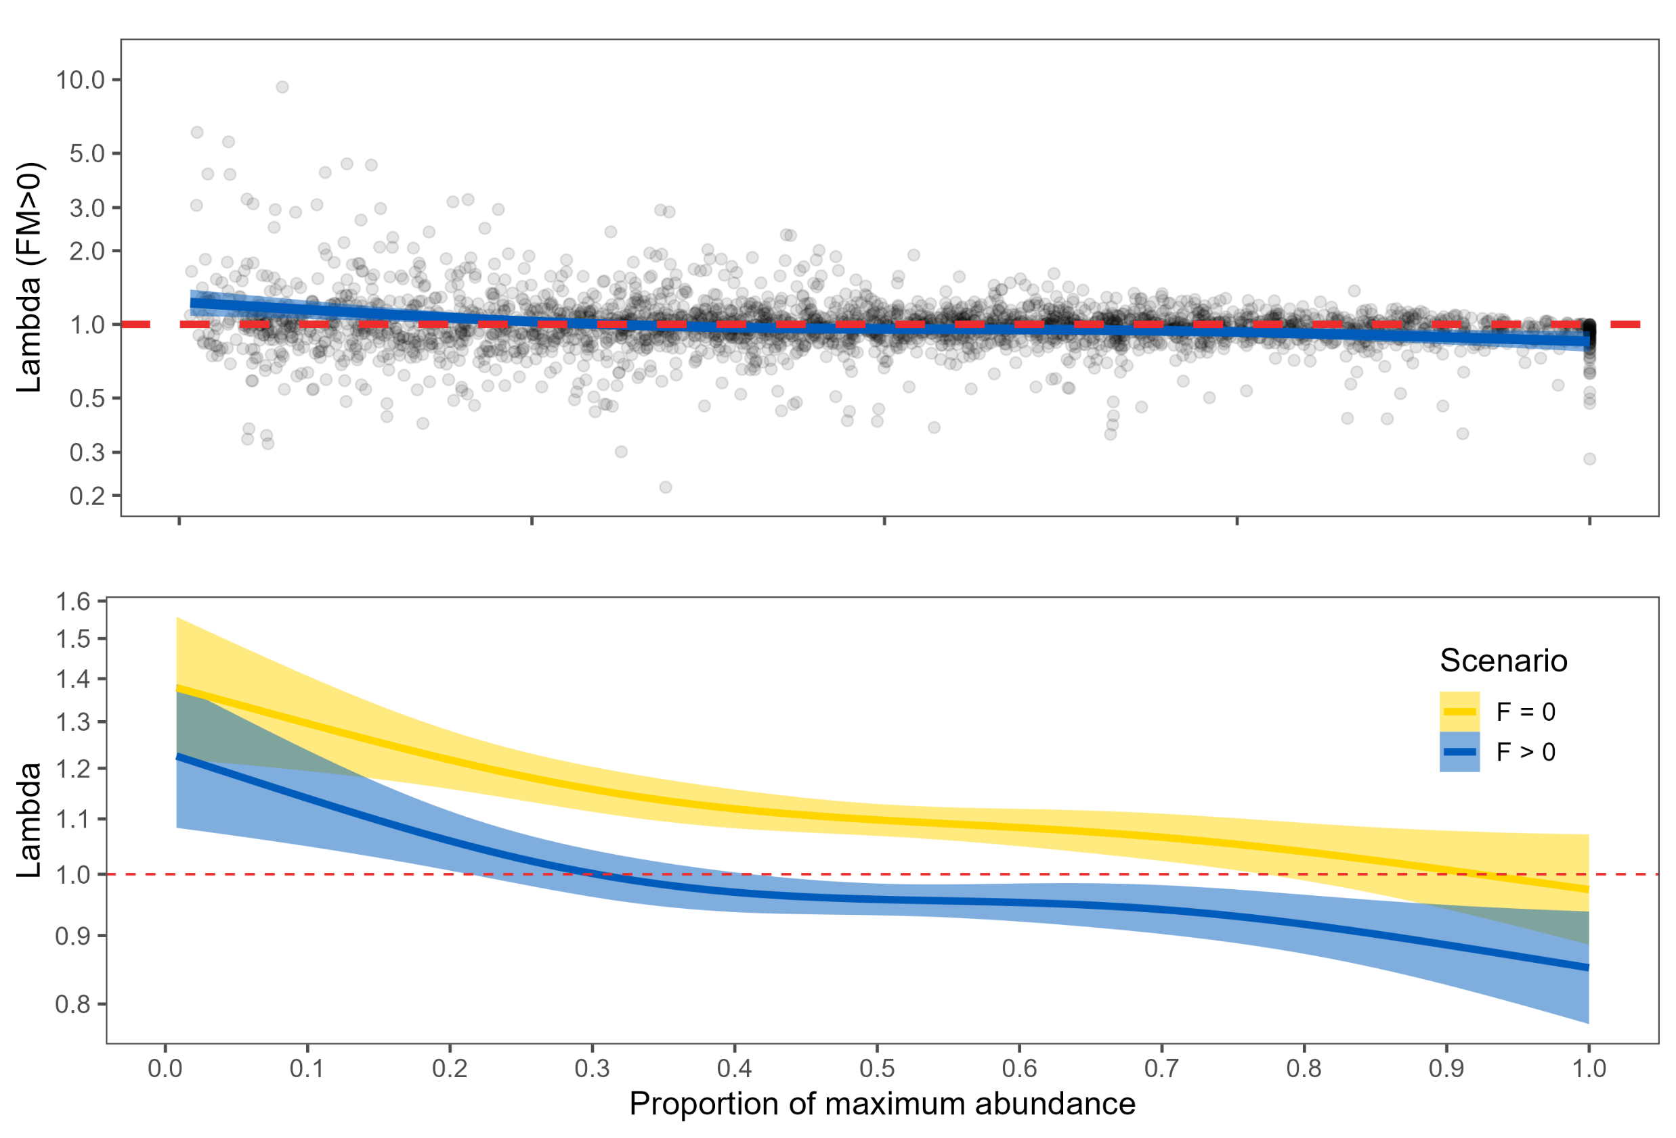
LTR General Takeaways
Account for density dependence
Near the maximum observed abundance stocks have lower capacity for growth
Years with High productivity are more likely at low abundance
But they are not ‘guaranteed’

Slide 15
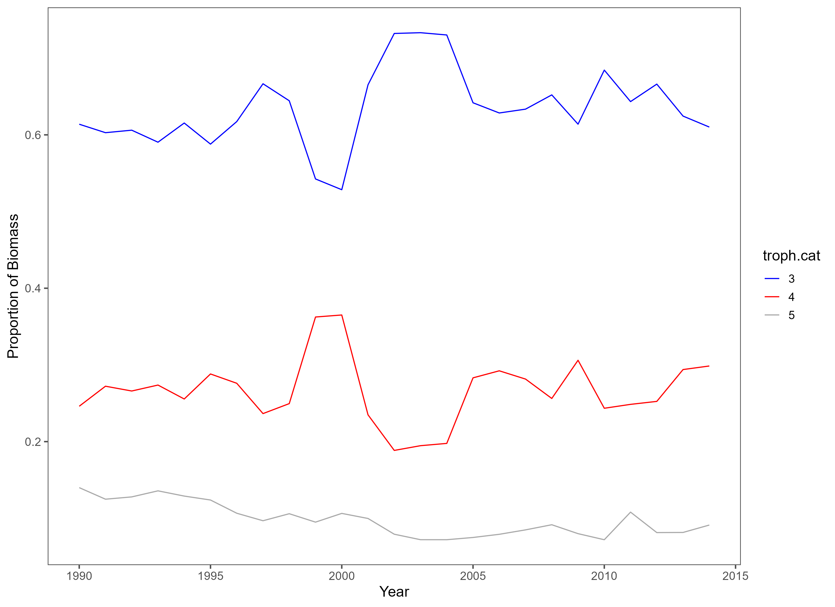
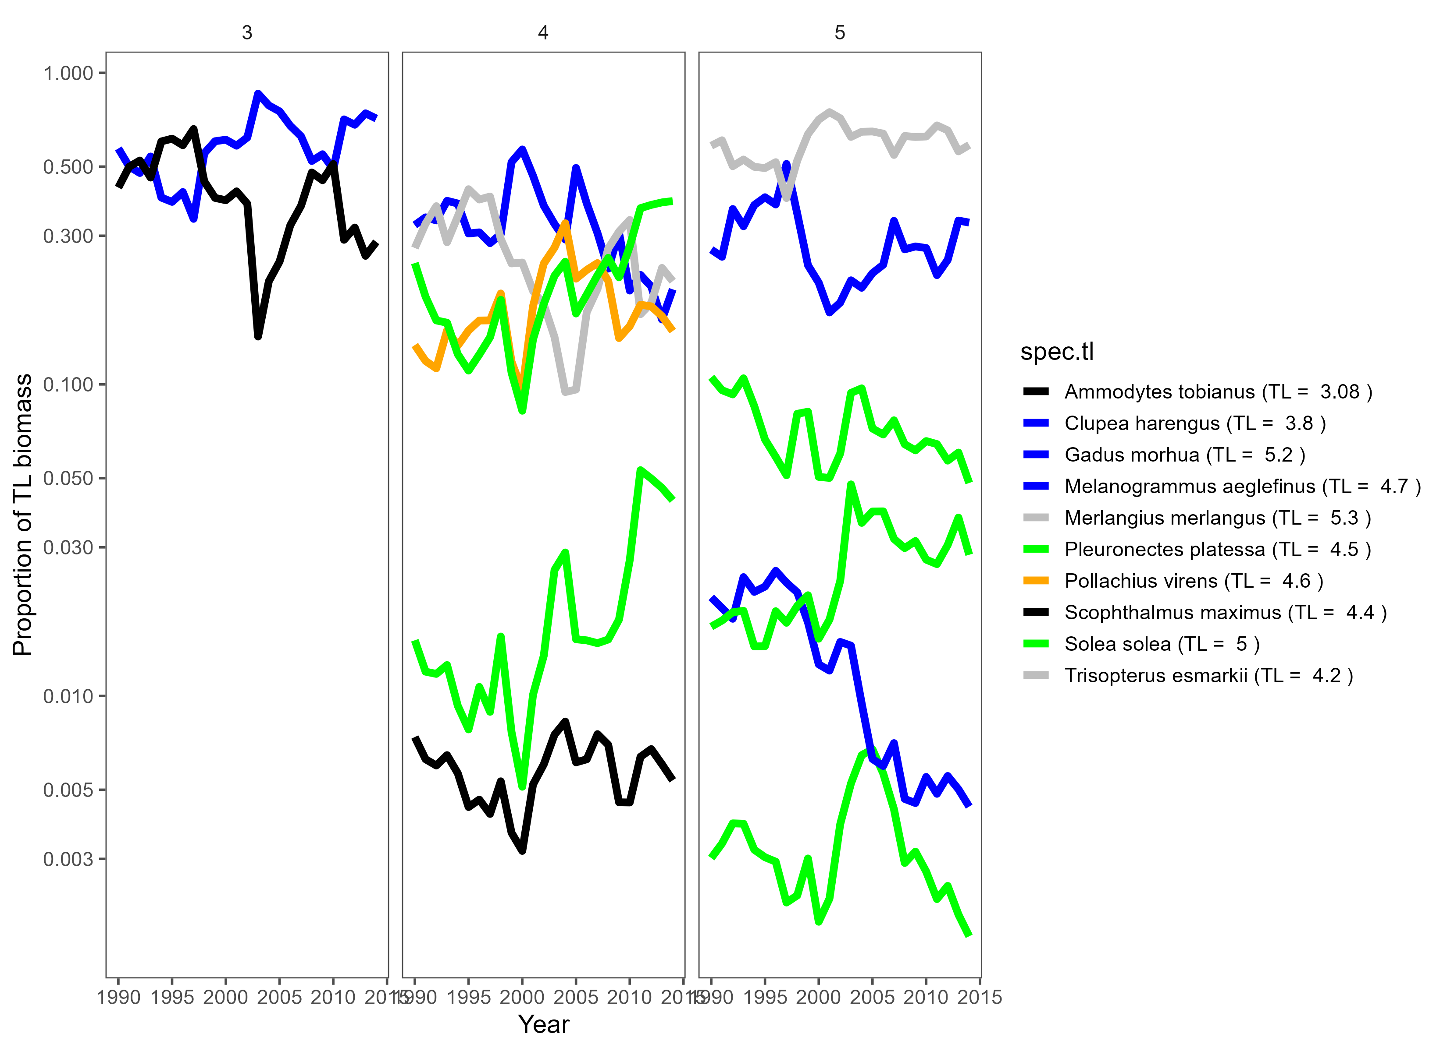
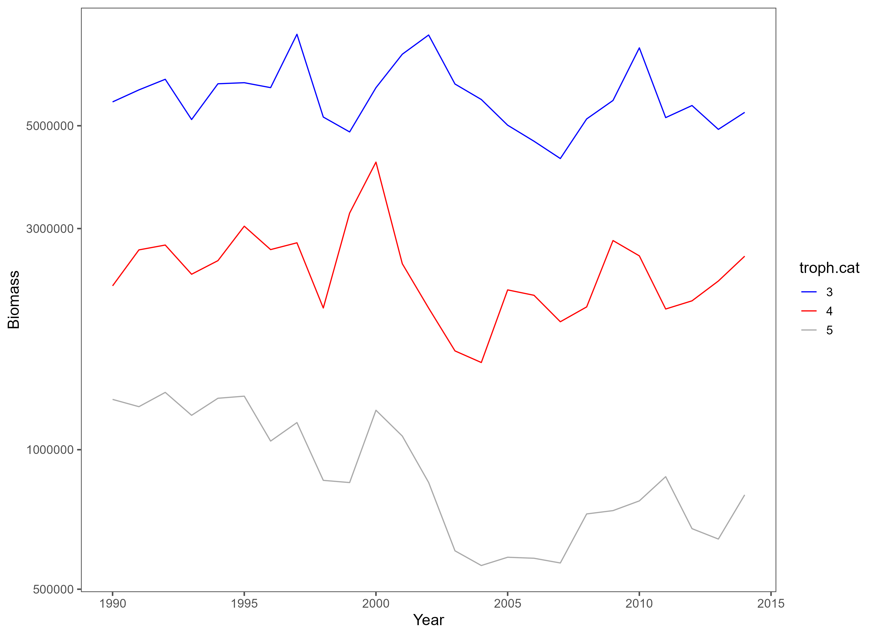
Back to the future
How to take LTR results and build an ecosystem
We are constraining ourselves to modelled stocks
We’ve taken a trophic level approach
K space
Interactions strongest within trophic levels
Weak interactions between trophic levels
Not really bottom up or top down

Slide 16
Back to the future
How to take LTR results and build an ecosystem
We are constraining ourselves to assessed stocks
We’ve taken a trophic level approach
K space!

Slide 17
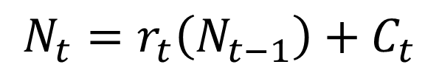
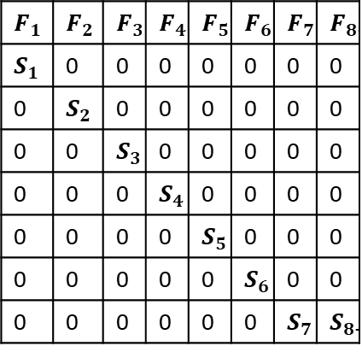
Back to the future
Life history Projection
For data rich stocks, we’re good!
For data poor stocks
Can we use survey data to parameterize our model?
Assumptions about natural mortality and catchability/selectivity
Availability of age structured data (at a minimum need recruits)
One could use life-history
Your results are meaningless in terms of a real-world ecosystem
You could do something in a ‘simulated world’
$$F_{1}$$ | $$F_{2}$$ | $$F_{3}$$ | $$F_{4}$$ | $$F_{5}$$ | $$F_{6}$$ | $$F_{7}$$ | $$F_{8+}$$
$$S_{1}$$ | 0 | 0 | 0 | 0 | 0 | 0 | 0
0 | $$S_{2}$$ | 0 | 0 | 0 | 0 | 0 | 0
0 | 0 | $$S_{3}$$ | 0 | 0 | 0 | 0 | 0
0 | 0 | 0 | $$S_{4}$$ | 0 | 0 | 0 | 0
0 | 0 | 0 | 0 | $$S_{5}$$ | 0 | 0 | 0
0 | 0 | 0 | 0 | 0 | $$S_{6}$$ | 0 | 0
0 | 0 | 0 | 0 | 0 | 0 | $$S_{7}$$ | $$S_{8+}$$
$$N_{t}=r_{t}\left(N_{t−1}\right)+C_{t}$$

Slide 18
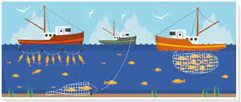
Back to the future
What about climate change?
Many options here
Productivity of the system
Biomass
Fecundity
Natural mortality
Rate of growth (r)
interactions

Slide 19
Topics of discussion
Modelling framework
Ecosystem Definition
Fishing Scenarios
Incorporating Climate

